Slide 1
Data Analytics
Exploratory Data Analysis (EDA)

Slide 2
Exploratory Data Analysis (EDA)
"At a high level, EDA is the practice of using visual and quantitative methods to understand and summarize a dataset without making any assumptions about its contents. It is a crucial step to take before diving into machine learning or statistical modeling because it provides the context needed to develop an appropriate model for the problem at hand and to correctly interpret its results." Chloe Mawer

Slide 3
Exploratory Data Analysis (EDA)
“In statistics, exploratory data analysis is an approach of analyzing data sets to summarize their main characteristics, often using statistical graphics and other data visualization methods.
Exploratory data analysis has been promoted by John Tukey since 1970 to encourage statisticians to explore the data, and possibly formulate hypotheses that could lead to new data collection and experiments.”
Wikipedia

Slide 4
EDA BASICS

Slide 5
Five-Number Summary
Summarise a numerical observation (i.e. a numeric column in a dataset) with five numbers:
Minimum
First quartile - Q1
Median or second quartile – Q2
Third quartile – Q3
Maximum
Provides a summary of the distribution of the observation (i.e. the numbers in the column).
Video example: https://www.youtube.com/watch?v=tpToLyZibKM

Slide 6
Five-Number Summary (contd.)
There are alternative formulas for calculating Q1 and Q3: https://mathworld.wolfram.com/Quartile.html
Interquartile range IQR = Q3 – Q1.

Slide 7
Outliers
Variance of a set of observations - a measure of how spread out the values in a dataset are around the average (mean). It tells us how much the individual numbers differ from the central value, on average.
Standard deviation of a set of observations - the square root of the variance.
Example: Standard deviation - Wikipedia

Slide 8
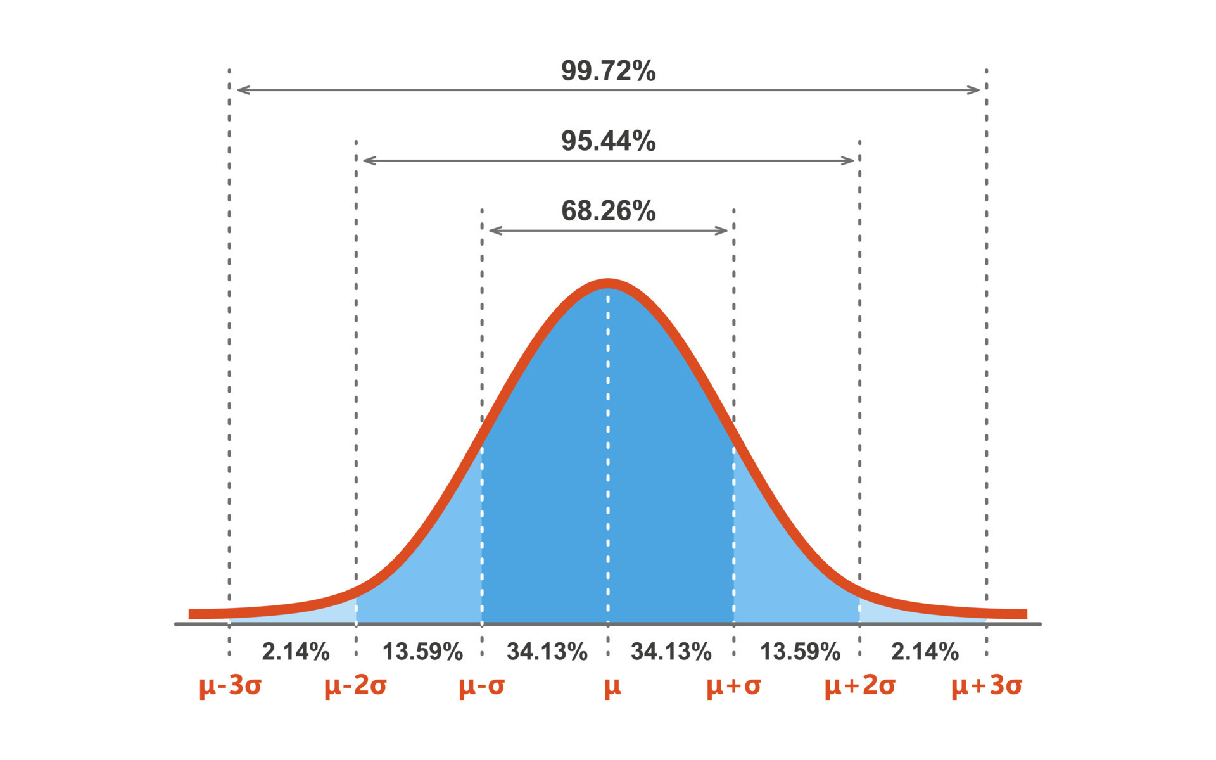
Outliers (contd.)
Gaussian distribution - Bell-Shaped Curve
μ - mean, σ - standard deviation

Slide 9
Outliers (contd.)
Outliers: values below Q1 – 1.5*IQR and above Q3 + 1.5*IQR
Q1−1.5×IQR and Q3+1.5×IQR roughly capture 99.3% of the data in a Gaussian distribution.

Slide 10
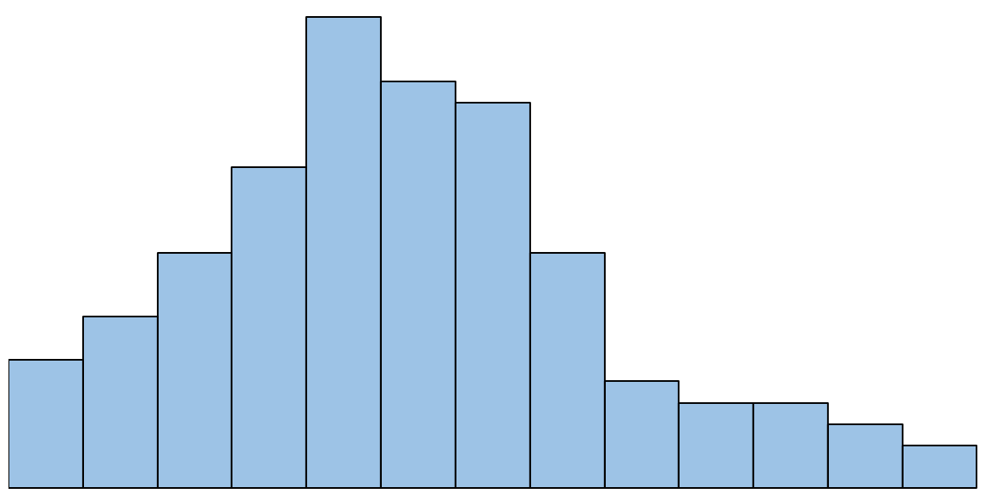
Histograms and Distributions
A histogram is a type of chart that visualises the distribution of values in a set of observations.
The x-axis displays the values and the y-axis shows the frequency of each value.

Slide 11
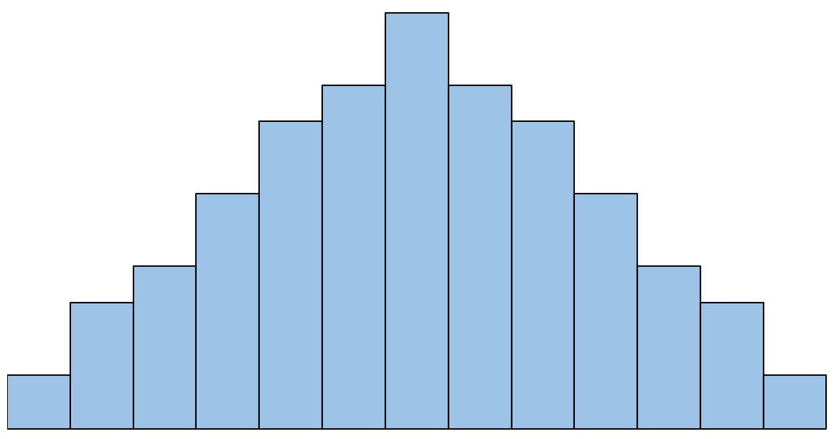
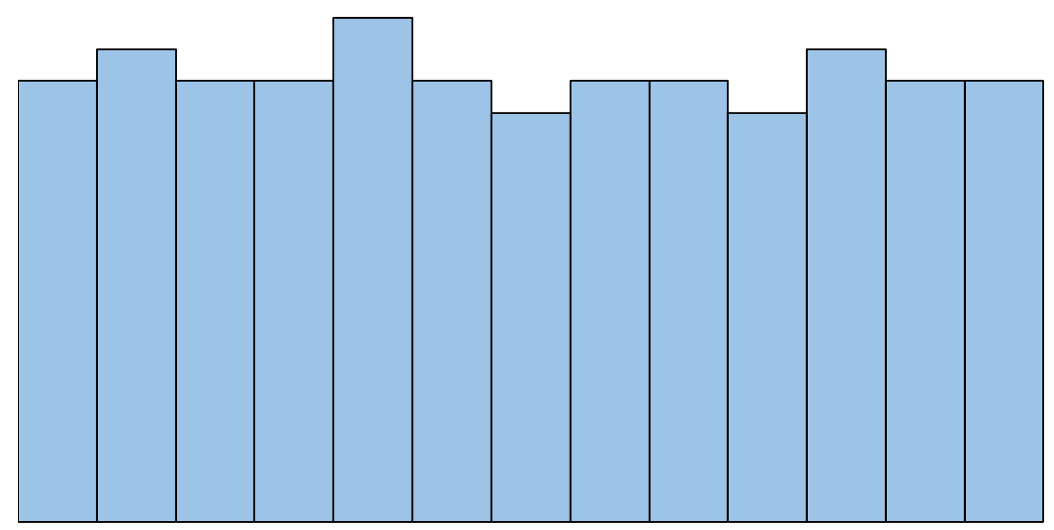
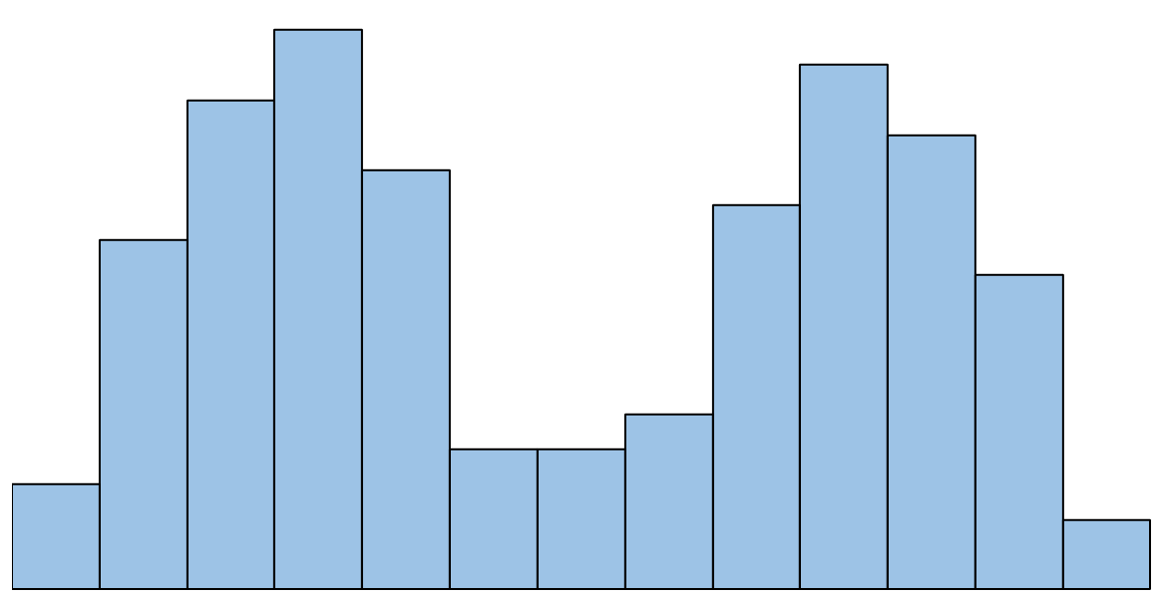
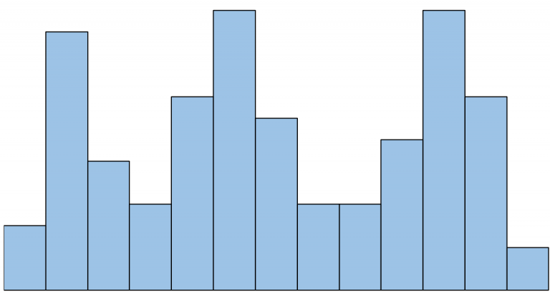
Histograms and Distributions
Gaussian/Normal
Uniform
Bimodal
Multimodal
How to Describe the Shape of Histograms (With Examples)

Slide 12
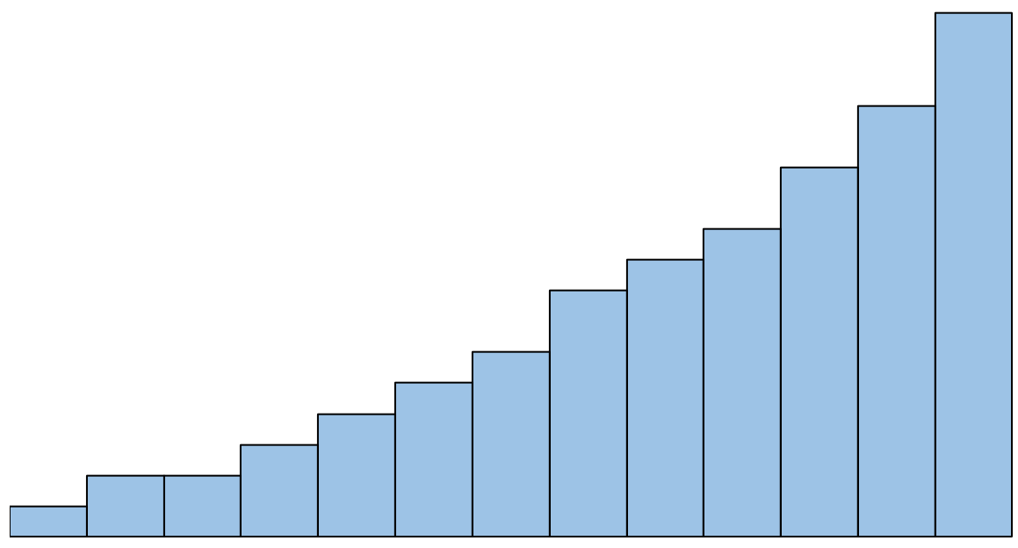
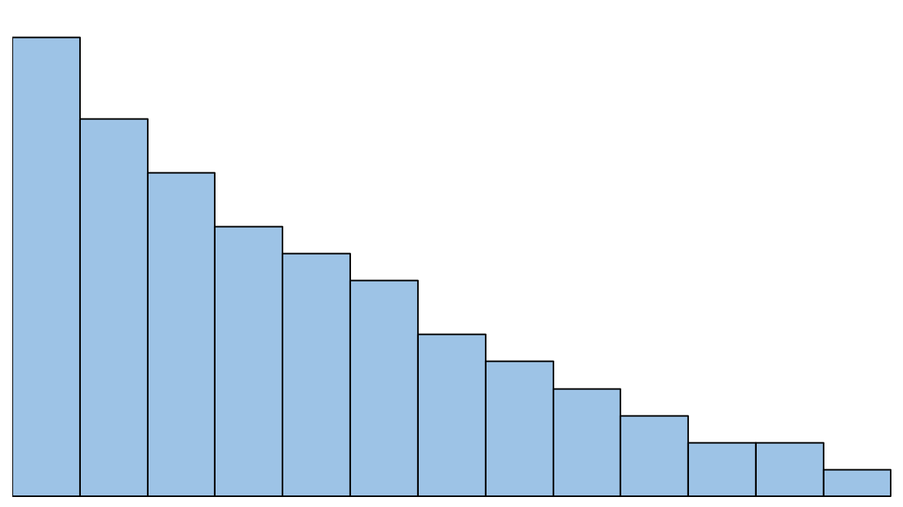
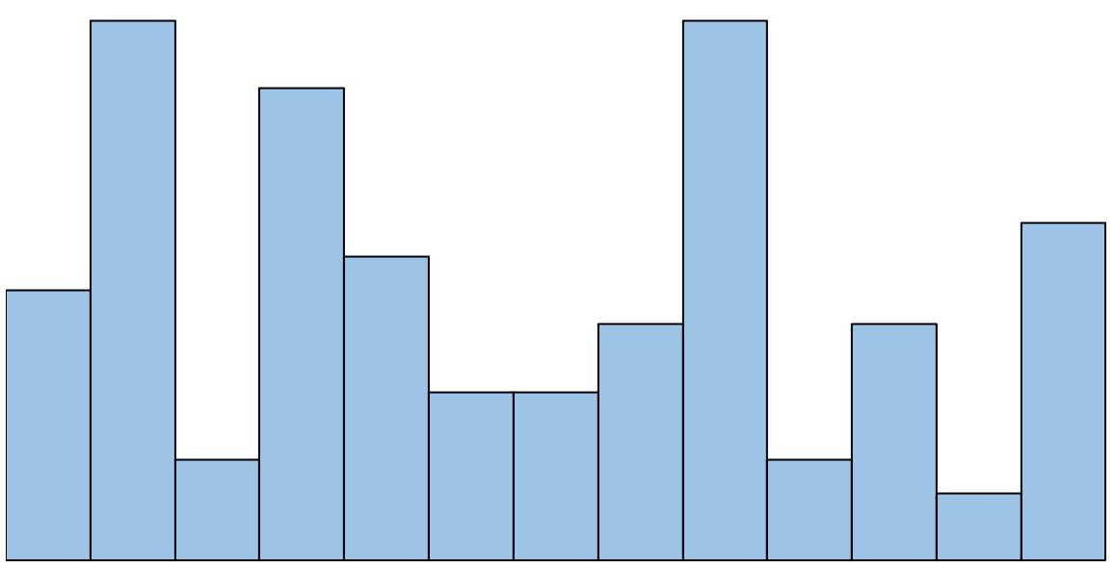
Histograms and Distributions
Left Skewed
Right Skewed
Random
How to Describe the Shape of Histograms (With Examples)

Slide 13
EDA Best PRACTICE

Slide 14
EDA Best Practice
Explore the data to understand its structure, quality, and potential issues before cleaning and preparing it for machine learning:
Check for Sampling Bias – Ensure the dataset represents the target population adequately.
Identify Data Quality Issues – Detect missing values, outliers, and noise.
Recognise Irrelevant Attributes – Remove non-informative columns (e.g., ID numbers, URLs).
Examine Data Distributions – Assess the statistical properties of each column.

Slide 15
EDA Best Practice (contd.)
Analyse Feature Relationships – Understand dependencies and interactions between variables.
Investigate Subgroup Variations – Identify patterns across different subsets of data.
Avoid Over-Interpreting Correlations – Consider confounding variables before inferring causation.
Report All Insights Fairly – Avoid cherry-picking findings to fit a narrative.
Acknowledge Limitations and Assumptions – Clearly document potential biases and constraints.

Slide 16
EDA Best Practice (contd.)
Note:
In general, EDA comes before data preparation.
We may look at portions of the data but we leave any transformations for the data preparation step that follows.

